Slide 1
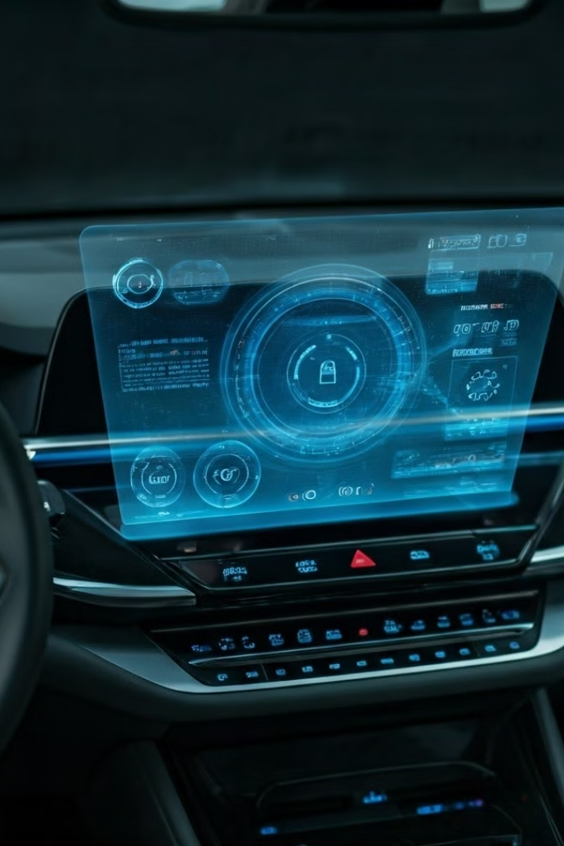

AI for Automotive Infotainment & Vision
Introducing an innovative AI-powered system for cars. It enhances infotainment and vision capabilities while reducing Wi-Fi dependency.
by Sohaib Aamir

Slide 2
Problem Statement
Problem
Solution
Current in-car AI relies heavily on external connections, causing inefficiencies and privacy concerns.
Custom AI-powered system using LLaMA 3.2 models for voice commands and vision functionalities.

Slide 3

Overview
1
Current Limitations
Constant Wi-Fi dependency, limited offline functionality, and privacy risks.
2
Our Solution
LLaMA 3.2 models enable offline voice control and real-time vision processing.

Slide 4
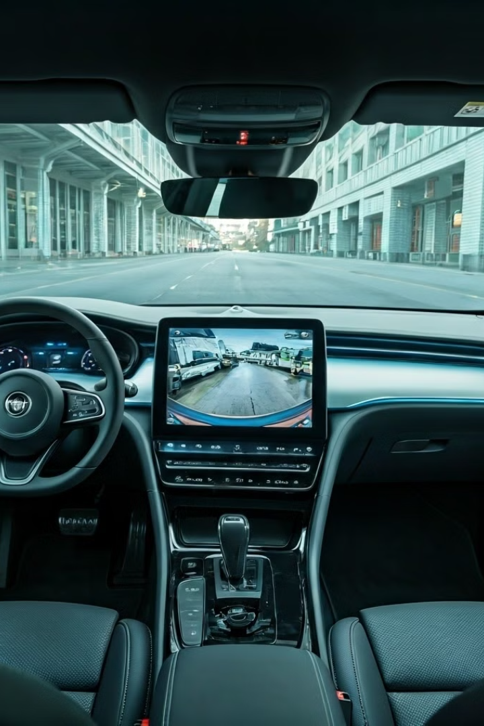
Functionality
1
Infotainment
Voice-controlled features for navigation, music, and climate control without external servers.
2
Vision Model
Camera data analysis for object detection and driver assistance.
3
Wi-Fi Optimization
Intelligent switching to Wi-Fi only when necessary, reducing bandwidth requirements.

Slide 5
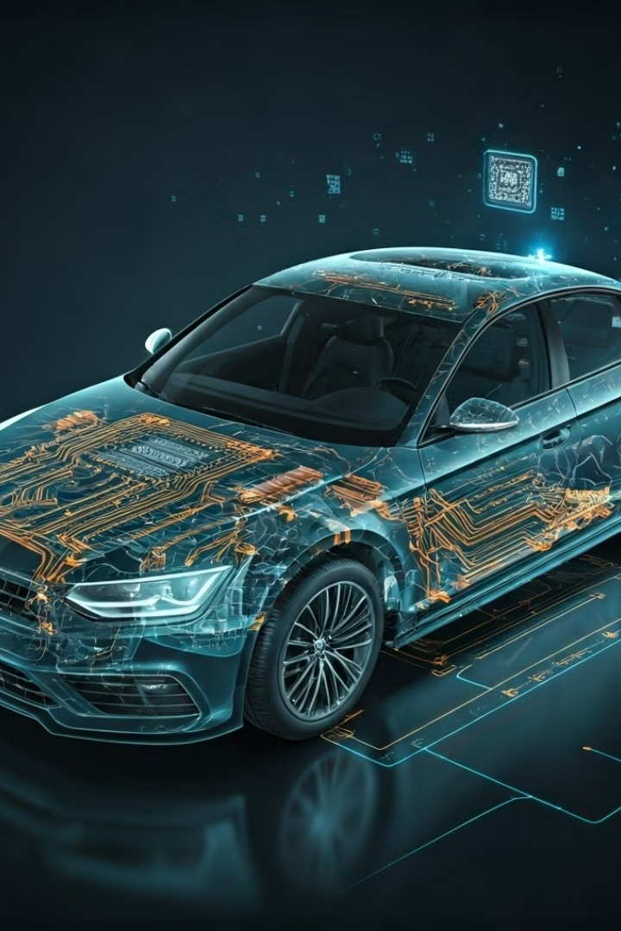
Solution Architecture
On-Device Processing
Ollama enables AI processing directly in the car, ensuring smart features without internet.
Frontend
Next.js creates an intuitive, user-friendly interface for car passengers.
Backend
Python-based system manages API calls, voice recognition, and vision processing models.

Slide 6
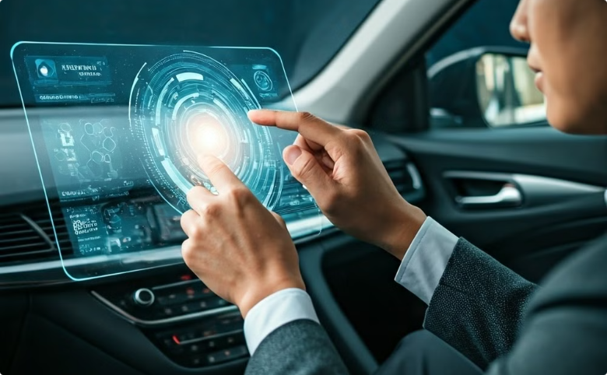
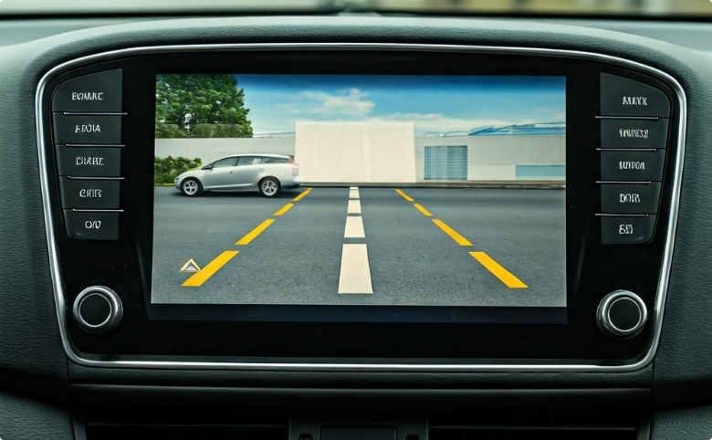
Demo
Voice Commands Demo
Vision Analysis Demo
Real-time voice control for music, navigation, and climate without Wi-Fi.
Camera footage processing for lane departure warnings and object detection.

Slide 7

Market Scope
Total Addressable Market (TAM)
$2 trillion automotive market
Serviceable Addressable Market (SAM)
$300 billion in global automotive AI by 2030

Slide 8
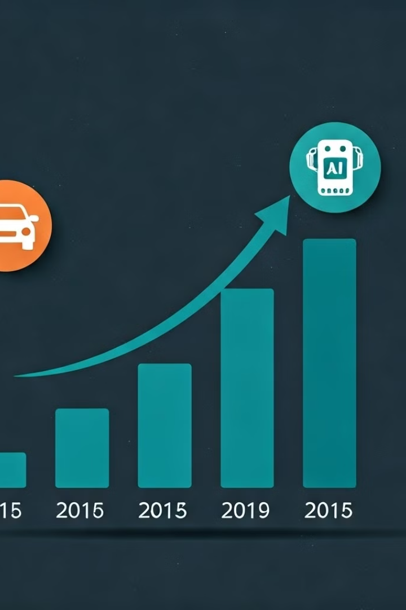


Revenue Streams
Subscription Model
Periodic updates and new features for voice and vision models.
Partnerships
Collaborations with automakers for system integration and continuous support.

Slide 9
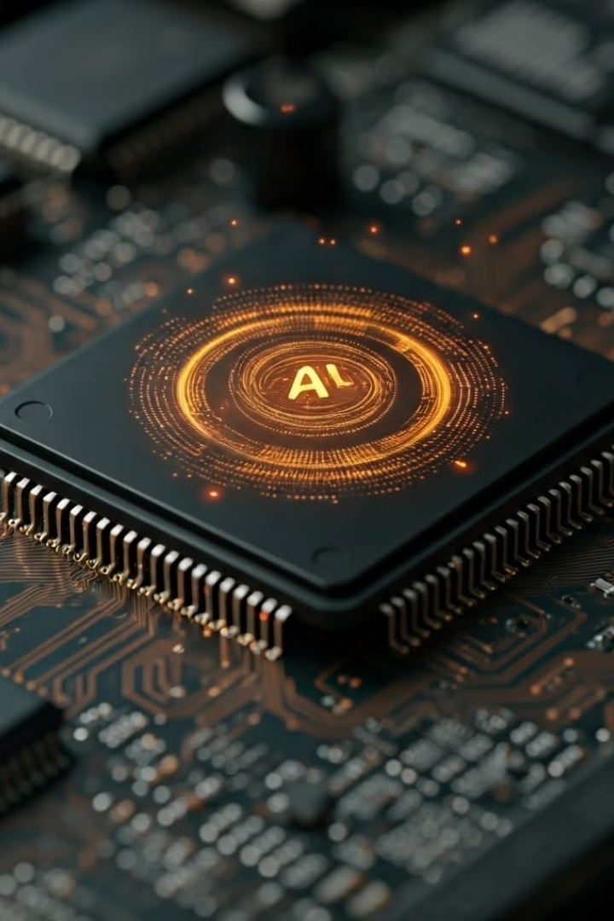


Innovation
On-Device AI
LLaMA models adapted for edge devices, enabling real-time functionalities in the car.
Edge Computing
Minimizing cloud reliance, reducing latency, and enhancing privacy through local processing.

Slide 10
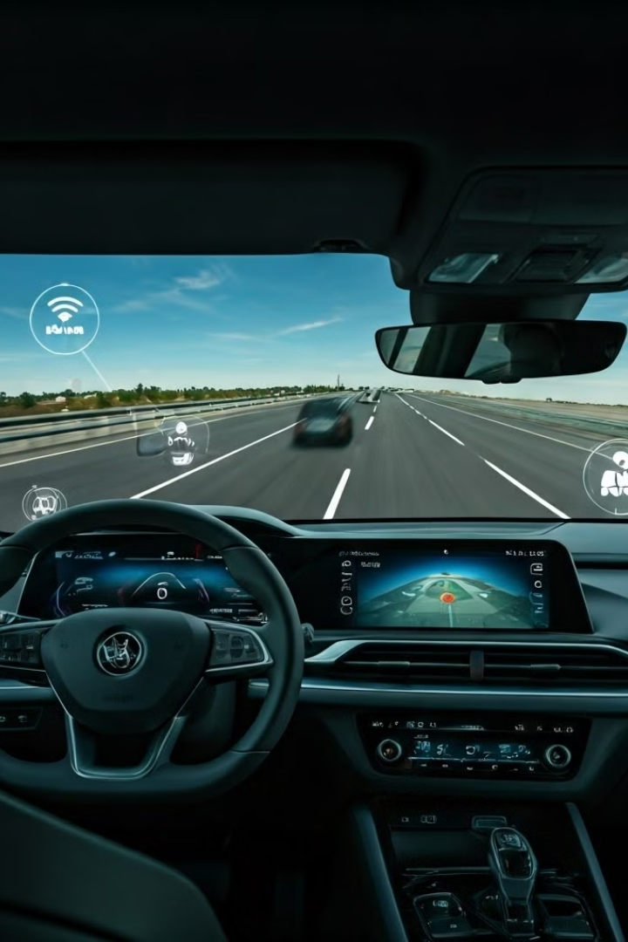
Future Outlook
1
5G & IoT Expansion
Leveraging faster connections while maintaining edge processing for key features.
2
Autonomous Driving & Safety
Enhancing vision model to support autonomous driving features.
3
Augmented Reality (AR)
Integrating AR into the car's heads-up display for enhanced navigation and safety.

